Slide 1

Exam skills – key vocab for writing and speaking
Hattie Sharp
Portchester Community College

Slide 2
Exam skills – key vocab for writing and speaking
Context of cohort from my last mocks
Very mixed ability group – Targets 9 – 2
Foundation tier - Reluctant speakers who are not a fan of extending language
Higher - often impeded by over extension and literal translation
Needed key support structures for production activities

Slide 3
Exam skills – key vocab for writing and speaking
En el pasado – in the past | Normalmente - normally | En el futuro – in the future
La semana pasada – last week | Ahora - now | Mañana - tomorrow
El año pasado – last year | Porque - because | La semana próxima – next week
Ayer - yesterday | Además - furthermore | Dado que – given that
Me gustó – I liked | Me encanta – I love | Sin embargo - however
Fue genial – it was great | Detesto – I hate | Planeo ir – I plan to go
Lo pasé bomba – I had a blast | Pienso que – I think that | Pero - but
Qué desastre – what a disaster | Creo que – I believe that | Va a ser guay – its going to be cool
También - also | En mi opinión – In my opinion | Diría que – I would say that
Key vocab list for F
Time phrases
Opinion starters
Set justifications in 3 tenses

Slide 4
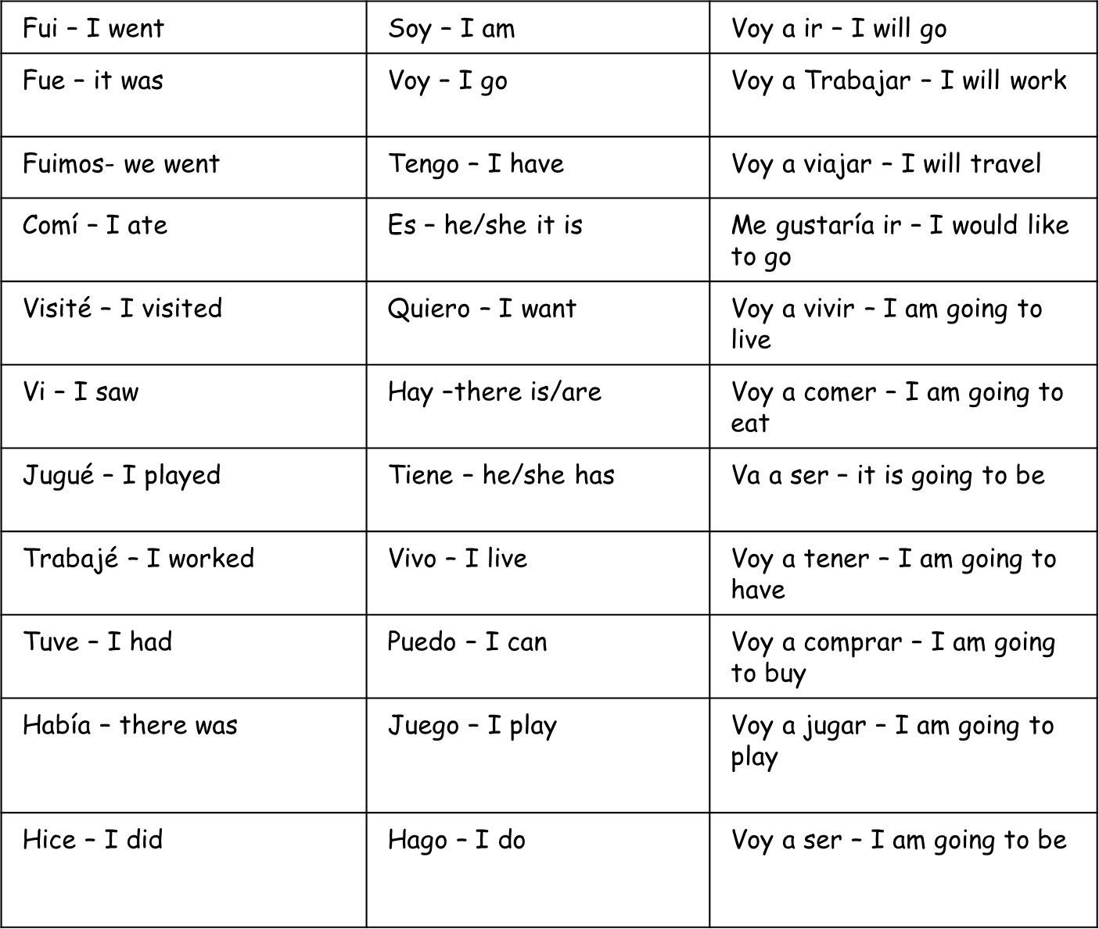
Exam skills – key vocab for writing and speaking
Key verb list for F and crossover
1st person verbs of the most part
3 clear time phrases
Opportunities for higher structures such as infinitive construction

Slide 5
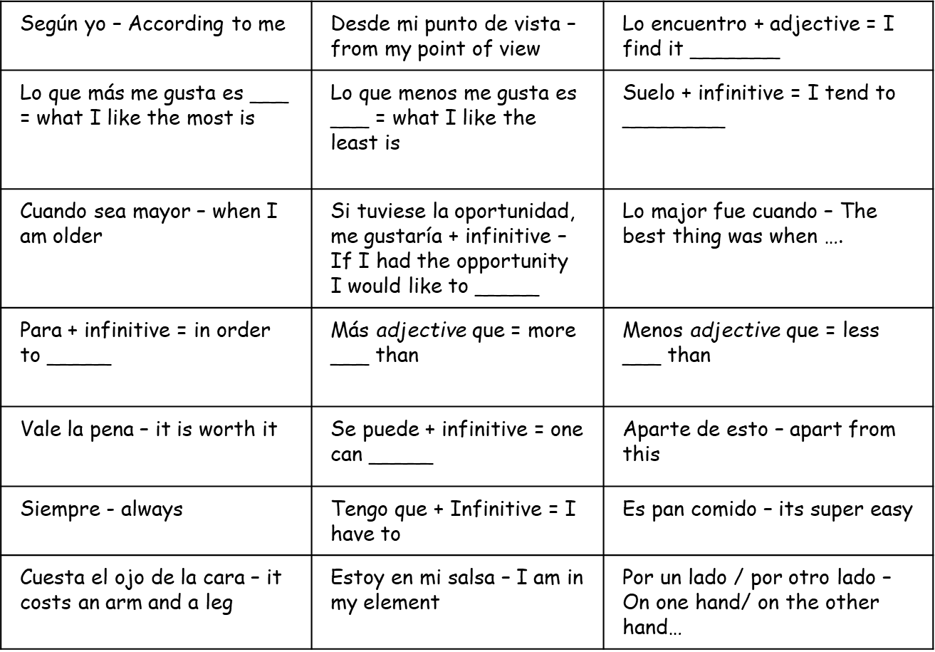
Exam skills – key vocab for writing and speaking
Key vocab list for H
Examples of complexity linked to AQA mark scheme
Controlled complexity over overextension and errors

Slide 6
Exam skills – key vocab for writing and speaking
Creation of flashcards + bingo grids
AI Flashcard Generator - Revisely

Slide 7
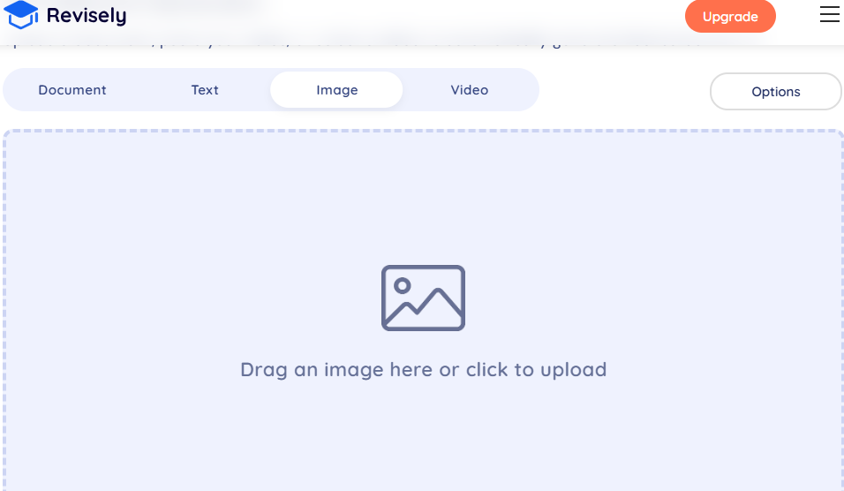
Exam skills – key vocab for writing and speaking

Slide 8
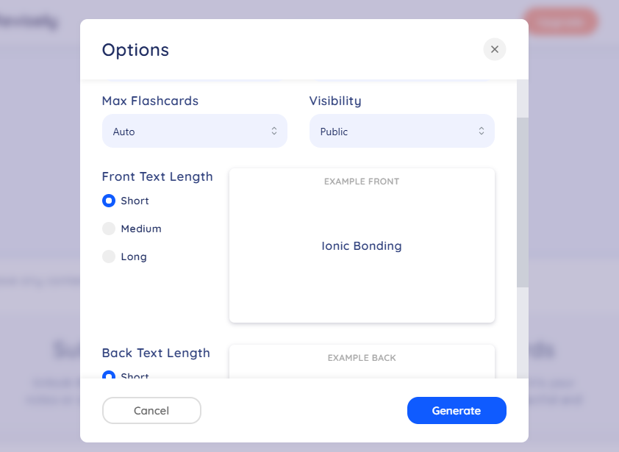
Exam skills – key vocab for writing and speaking

Slide 9
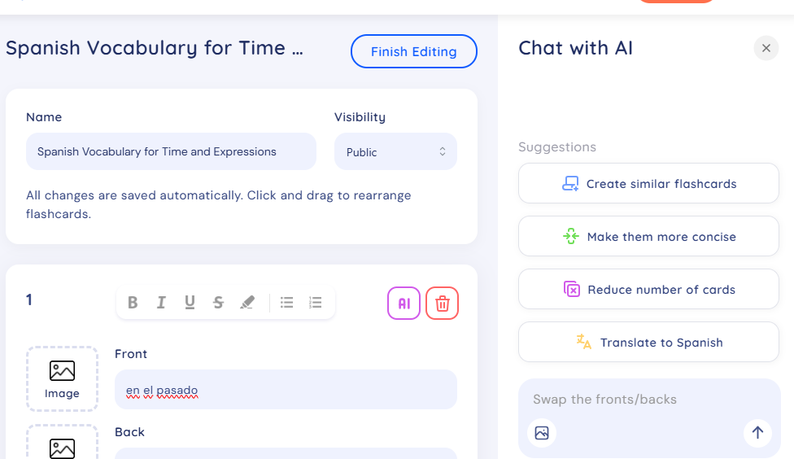
Exam skills – key vocab for writing and speaking

Slide 10
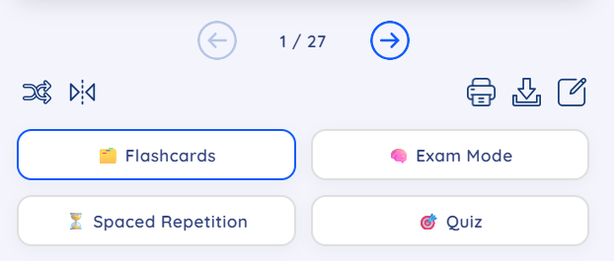
Exam skills – key vocab for writing and speaking

Slide 11
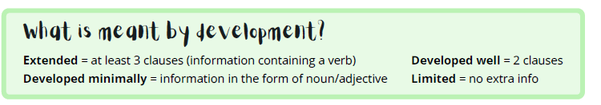
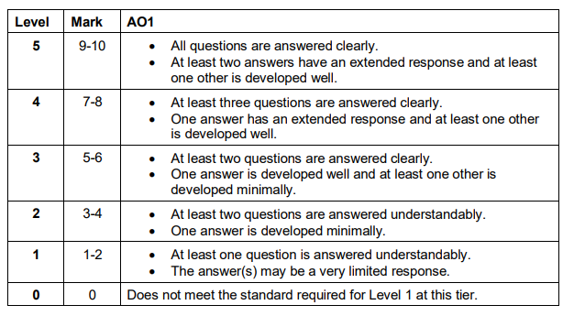
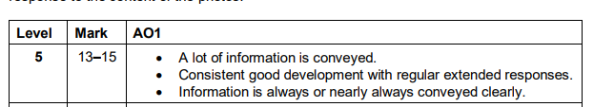
Exam skills – key vocab for writing and speaking
Examples of production activities to
scaffold boosting content marks

Slide 12
Exam skills – key vocab for writing and speaking
¿Qué prefieres beber?
__________ beber coca cola __________ es delicioso. También no es _______________.
What could go in the gap?

Slide 13
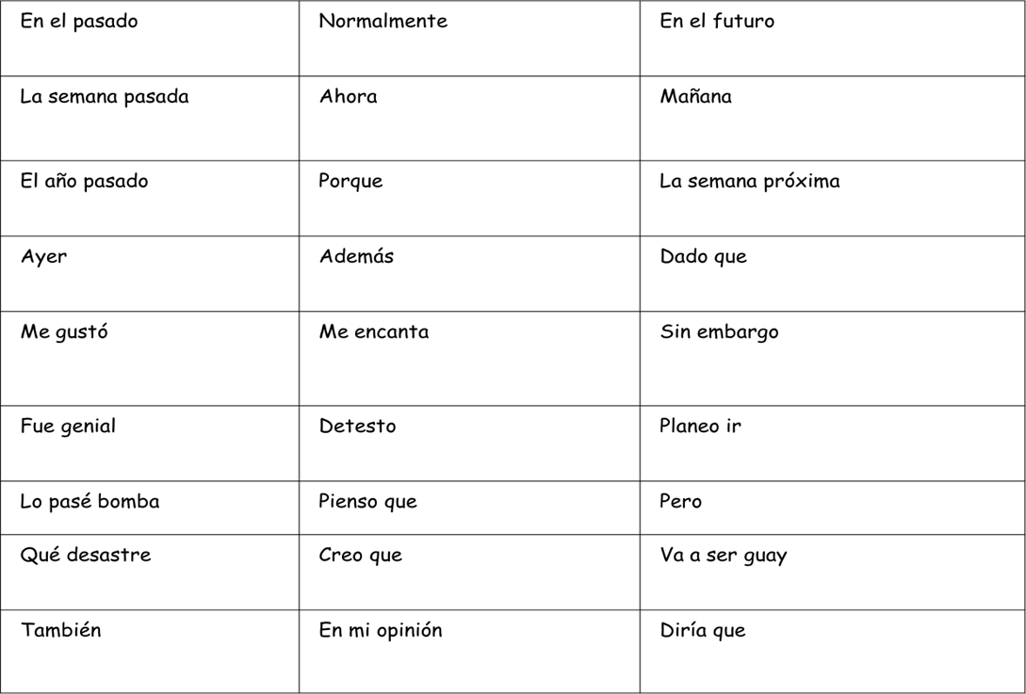
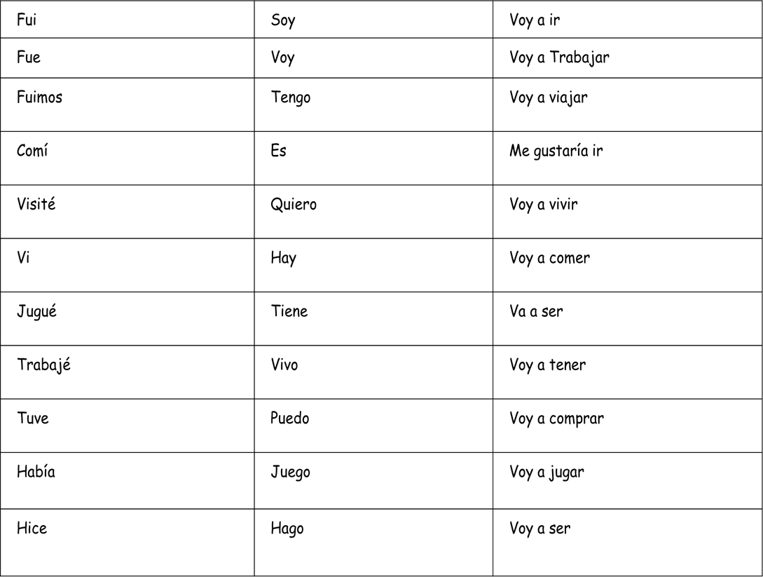
Exam skills – key vocab for writing and speaking
Translation challenge: 10 minutes – how many of these can you translate?

Slide 14
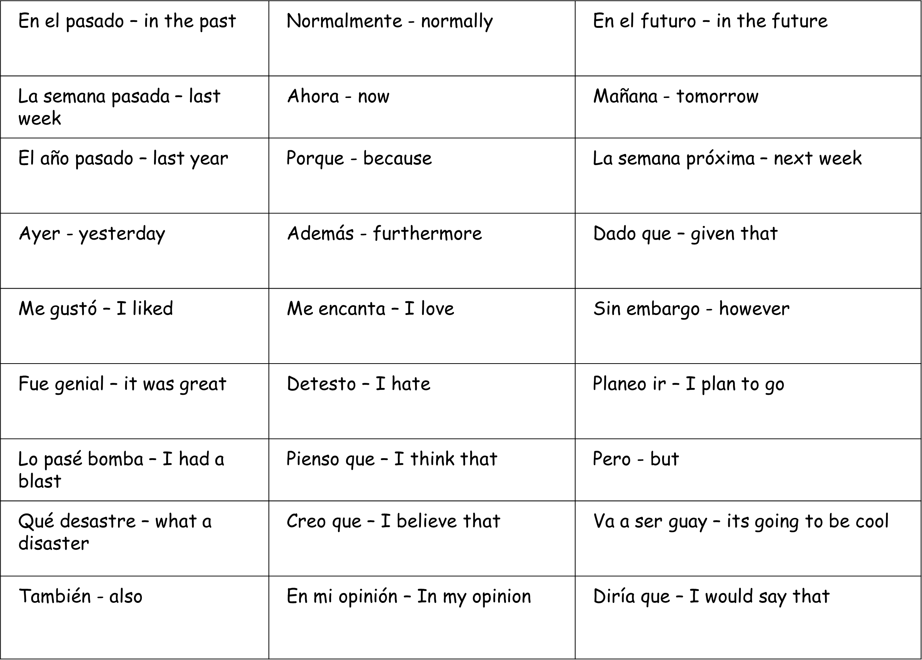
viernes, 6 de marzo de 2026

Slide 15
grow your sentence!
Exam skills – key vocab for writing and speaking
Describe your holiday from last year
Challenge: try including the following words:
porque – because
pero – but
A veces- sometimes
Support : Use your notes and knowledge organiser
Fui a

Slide 16
grow your sentence!
Exam skills – key vocab for writing and speaking
Describe what your best friend is like
Challenge: try including the following words:
porque – because
pero – but
A veces- sometimes
Support : Use your notes and knowledge organiser
Mi mejor amigo es

Slide 17
grow your sentence!
Exam skills – key vocab for writing and speaking
Describe where you will study in the future
Challenge: try including the following words:
porque – because
pero – but
A veces- sometimes
Support : Use your notes and knowledge organiser
Voy a estudiar en

Slide 18
Exam skills – key vocab for writing and speaking
Whiteboard 1: what you think of the place where you live
Whiteboard 2: a recent trip you went on
Whiteboard 3: what you would like to do in the summer holidays this year.

Slide 19
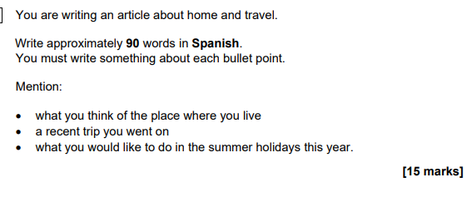
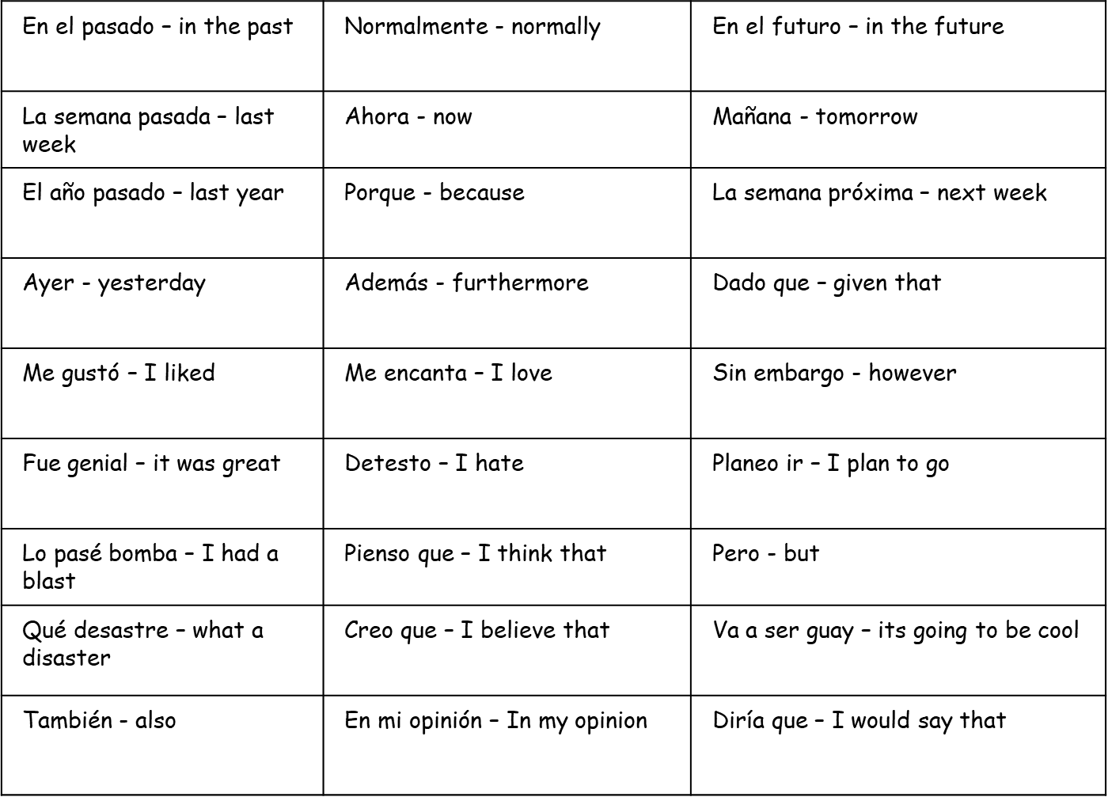
Exam skills – key vocab for writing and speaking
Paired writing -15 minutes

Slide 20
Exam skills – key vocab for writing and speaking
¿Qué prefieres comer?
Me encanta comer chocolate porque es muy rico. Sin embargo no es saludable.
Change my answer

Slide 21
Exam skills – key vocab for writing and speaking
¿Qué hiciste el verano pasado?
En el pasado fui a Italia con mis amigos. Fue genial ya que visité monumentos.
Change my answer

Slide 22
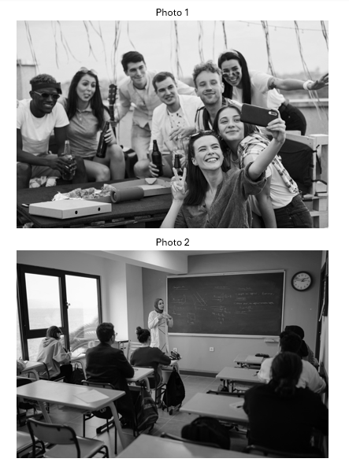
Exam skills – key vocab for writing and speaking
En foto una hay | estudiantes | Parecen contentos
Una celebración | En foto dos hay | Están sonriendo
amigos | Una clase | Pienso que es un grupo de … .
Hay una profesora | Hay bebidas | Hay…… personas
Muchas personas | Están en …. | Un barco
Botellas | sillas | hombres

Slide 23
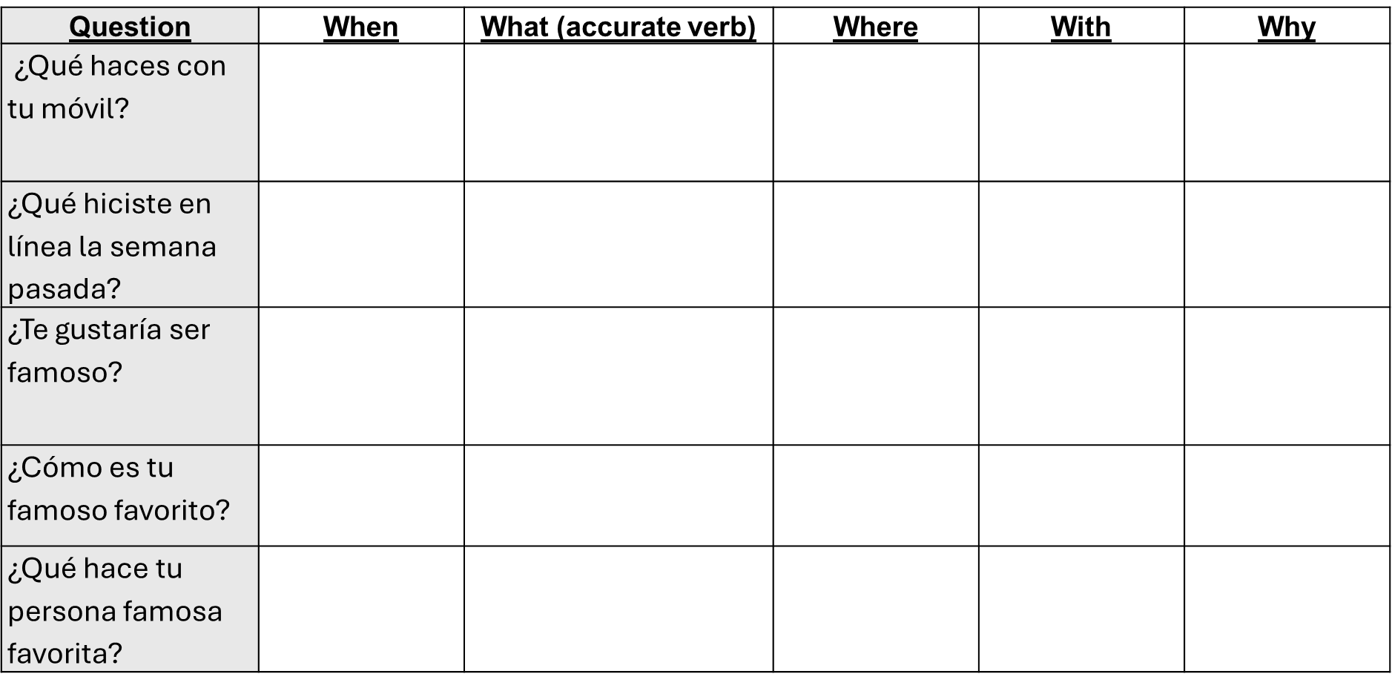
Exam skills – key vocab for writing and speaking

